Slide 1

Subtract - Computer Arithmetic
Computer Organization and Architecture | Computer Arithmetic
Course: Computer Organization and Architecture | Chapter: Computer Arithmetic | Bachelor of Engineering
DISCOVER · LEARN · EMPOWER
Notes:
Welcome everyone to today's lecture on Computer Arithmetic. We will focus specifically on the subtraction operation, a fundamental building block of the Arithmetic Logic Unit. As we explore this topic, remember that subtraction is essentially addition with a twist involving complements. Let us begin our journey into the hardware implementation of this essential operation.

Slide 2
Course Outcomes
SLIDE 2 / 10
Course Outcome
CO | BT LEVEL | DESCRIPTION
CO1 | BT3 | Apply number systems and digital logic to design basic digital circuits
CO2 | BT4 | Analyze register organization and instruction set architecture
CO3 | BT3 | Implement computer arithmetic algorithms and floating-point operations
CO4 | BT5 | Analyze memory hierarchy and input-output organization
CO5 | BT6 | Evaluate control unit design and pipelining performance
Chandigarh University
2 / 10
Notes:
Today's lecture directly addresses Course Outcome 3, which requires you to implement computer arithmetic algorithms. By understanding how subtraction is performed at the hardware level, you will be able to design efficient arithmetic circuits. This skill is crucial for developing processors that handle both integer and floating-point operations effectively.

Slide 3
Learning Objectives
SLIDE 3 / 10
Learning Outcomes
1
Define the fundamental concept of binary subtraction in digital systems.
2
Analyze the role of complements in simplifying subtraction hardware.
3
Evaluate the differences between 1's complement and 2's complement methods.
4
Apply the 2's complement algorithm to perform binary subtraction manually.
5
Demonstrate the hardware implementation of a subtractor circuit using adders.
Chandigarh University
3 / 10
Notes:
By the end of this session, you will be able to define binary subtraction and analyze how complements simplify the process. We will evaluate the differences between 1's and 2's complement methods to understand why the latter is preferred. You will apply these algorithms manually and demonstrate how subtractors are built using adders.

Slide 4
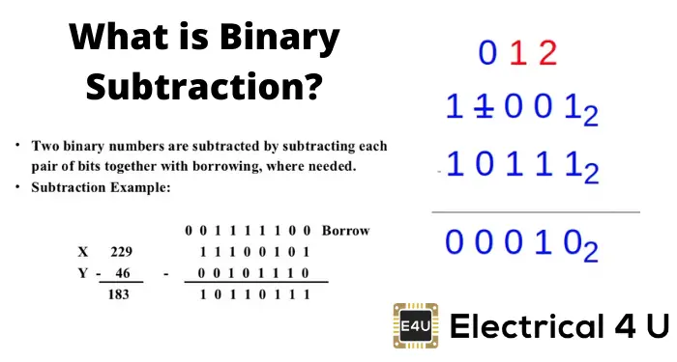
Lecture
SLIDE 4 / 10
Binary Subtraction Basics
1
Binary subtraction follows the same rules as decimal subtraction but uses base 2.
2
The operation involves subtracting a subtrahend from a minuend to find the difference.
3
Borrowing occurs when the minuend bit is 0 and the subtrahend bit is 1.
4
A borrow from the next higher bit adds 2 to the current bit position.
5
The result of subtraction is always a binary number representing the difference.
Binary Subtraction (How To Guide With Rules And Examples) | Electrical4U
Chandigarh University
4 / 10
Notes:
Binary subtraction mirrors decimal subtraction but operates in base 2. When you encounter a 0 minus 1, you must borrow from the next higher bit, which adds 2 to the current position. For example, subtracting 1 from 0 requires a borrow, turning the 0 into 2, so 2 minus 1 equals 1.

Slide 5
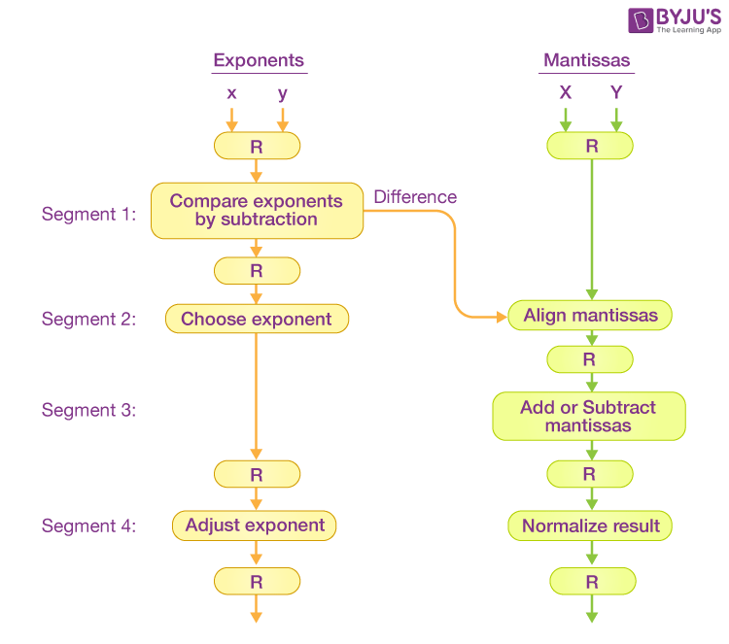
Lecture
SLIDE 5 / 10
1's Complement Method
1
The 1's complement of a binary number is obtained by inverting all bits.
2
Subtraction is performed by adding the 1's complement of the subtrahend to the minuend.
3
If an end-around carry occurs, it must be added back to the result.
4
If no carry occurs, the result is negative and represented in 1's complement.
5
This method requires two steps to handle the end-around carry condition.
Arithmetic Pipeline in Computer Architecture (source: cdn1.byjus.com)
Chandigarh University
5 / 10
Notes:
The 1's complement method involves inverting all bits of the subtrahend and adding it to the minuend. If an end-around carry is generated, you must add it back to the least significant bit. If no carry occurs, the result is negative and stored in 1's complement form, which can be confusing for hardware design.

Slide 6
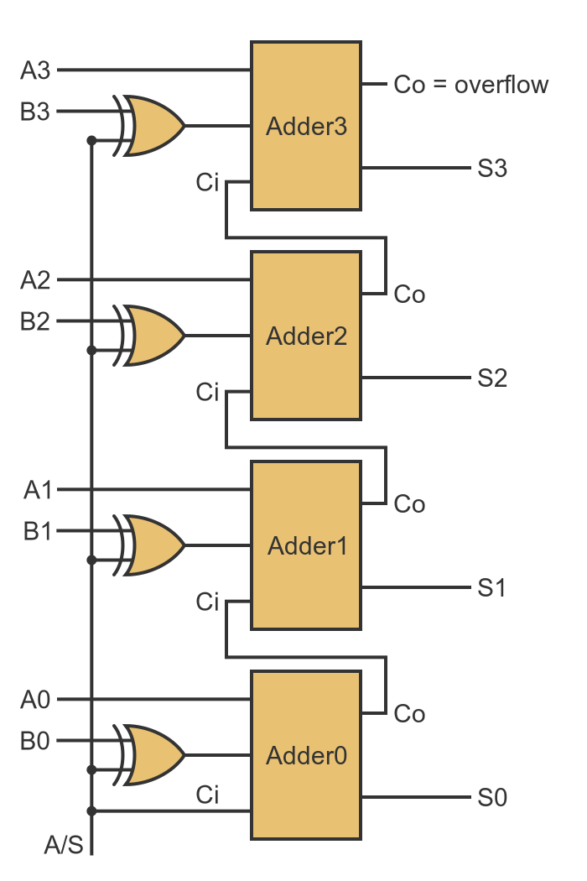
Lecture
SLIDE 6 / 10
2's Complement Method
1
The 2's complement is found by taking the 1's complement and adding 1.
2
Subtraction is performed by adding the 2's complement of the subtrahend to the minuend.
3
Any end carry generated is simply discarded to get the final result.
4
If no carry is generated, the result is negative and in 2's complement form.
5
This method eliminates the need for end-around carry logic in hardware.
GraphicMaths - Creating a subtractor with logic gates (source: graphicmaths.com)
Chandigarh University
6 / 10
Notes:
The 2's complement method is superior because it simplifies the hardware design. You find the 2's complement by inverting bits and adding 1, then add it to the minuend. Any carry generated is simply discarded, and if no carry occurs, the result is negative in 2's complement form.

Slide 7
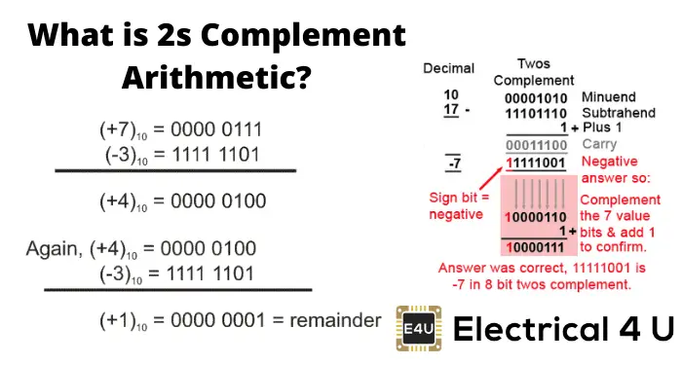
Lecture
SLIDE 7 / 10
Worked Numerical Example
VERIFICATION
10 minus 5 equals 5, confirming the calculation is correct.
• Subtract 0101 (5) from 1010 (10) using 2's complement method.
• Find 2's complement of 0101: invert to 1010, add 1 to get 1011.
• Add 1010 (minuend) and 1011 (complement): result is 10101.
• Discard the end carry 1, leaving the result 0101 (5).
Source: www.electrical4u.com
Chandigarh University
7 / 10
Notes:
Let's work through an example: subtracting 5 from 10. First, find the 2's complement of 5 (0101) by inverting to 1010 and adding 1 to get 1011. Add this to 10 (1010) to get 10101. Discard the carry, leaving 0101, which is 5. This confirms our subtraction was successful.

Slide 8
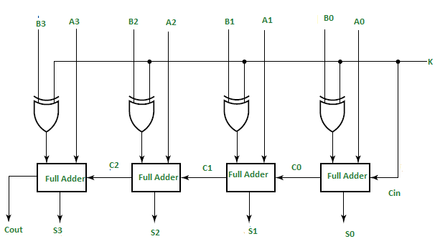
Lecture
SLIDE 8 / 10
Hardware Implementation
1
Subtractors can be implemented using full adders and inverters.
2
A control signal determines whether the circuit performs addition or subtraction.
3
When subtraction is selected, the subtrahend bits are inverted before addition.
4
The carry-in input is set to 1 to complete the 2's complement operation.
5
This design allows a single circuit to perform both addition and subtraction.
Source: media.geeksforgeeks.org
Chandigarh University
8 / 10
Notes:
Hardware implementation uses full adders combined with inverters controlled by a single signal. When subtraction is needed, the subtrahend bits are inverted, and the carry-in is set to 1. This clever design allows a single circuit to perform both addition and subtraction efficiently.

Slide 9
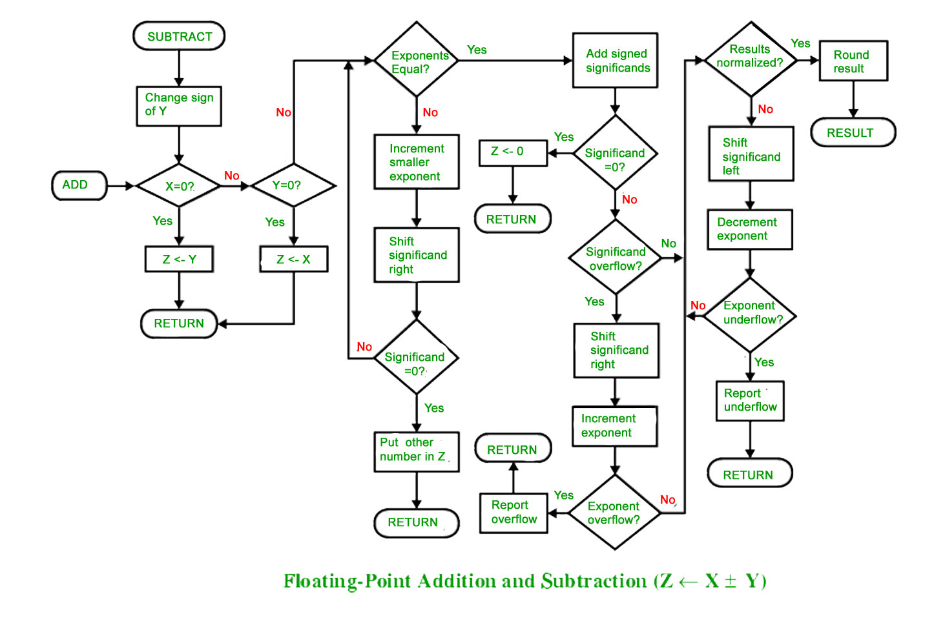
Lecture
SLIDE 9 / 10
Key Takeaways
1
Binary subtraction relies on borrowing or complement methods for implementation.
2
2's complement is the preferred method due to its simplicity in hardware.
3
End-around carry is required for 1's complement but not for 2's complement.
4
A single adder circuit can perform subtraction by inverting the subtrahend.
5
Understanding complements is essential for designing efficient arithmetic logic units.
Source: media.geeksforgeeks.org
Chandigarh University
9 / 10
Notes:
To summarize, binary subtraction can be done via borrowing or complements, with 2's complement being the hardware standard. The key advantage is that it eliminates the need for end-around carry logic. A single adder circuit can handle both operations by inverting the subtrahend and setting the carry-in. Mastering these concepts is vital for your understanding of computer arithmetic.

Slide 10
Lecture
SLIDE 10 / 10
References
COMPUTER ORGANIZATION AND DESIGN
The Hardware/Software Interface — David A. Patterson, John L. Hennessy
COMPUTER ARCHITECTURE
A Quantitative Approach — John L. Hennessy, David A. Patterson
• Computer Organization and Architecture — William Stallings
• Computer System Architecture — M. Morris Mano & Rajib Mall
• Computer Organization — Carl Hamacher, Zvonko Vranesic, Safwat Zaky
Chandigarh University
10 / 10
Notes:
For further reading, I recommend the textbooks listed here, which provide comprehensive coverage of computer arithmetic. William Stallings and M. Morris Mano offer excellent foundational knowledge on this topic. David A. Patterson and John L. Hennessy provide deeper insights into hardware/software interfaces. Please review these resources to reinforce your understanding of subtraction algorithms.

